Slide 1





Luke Garrigan + Shane Sturgeon

Slide 2
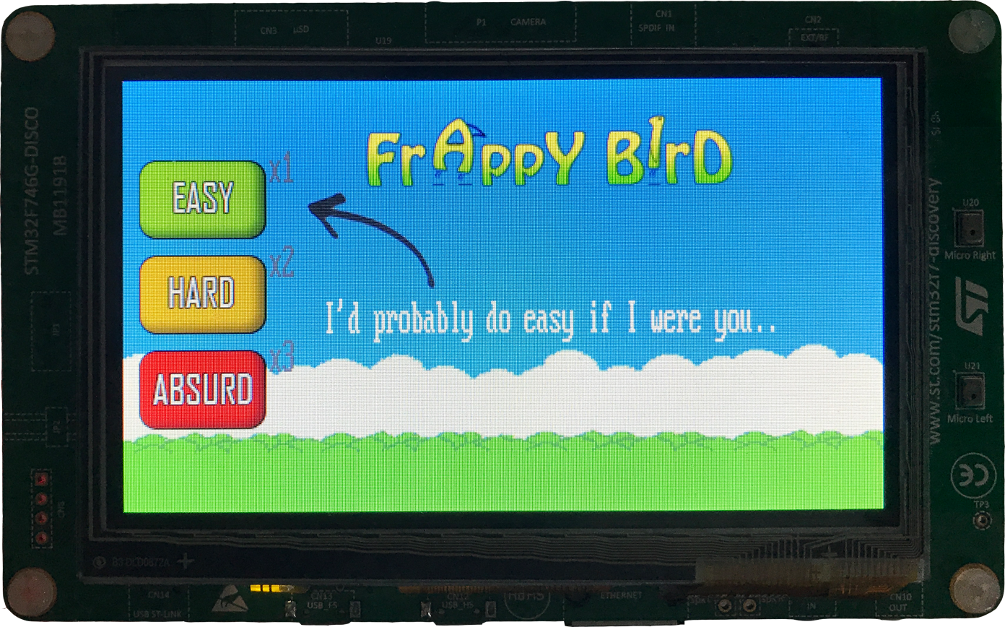
First Game Screen

Slide 3
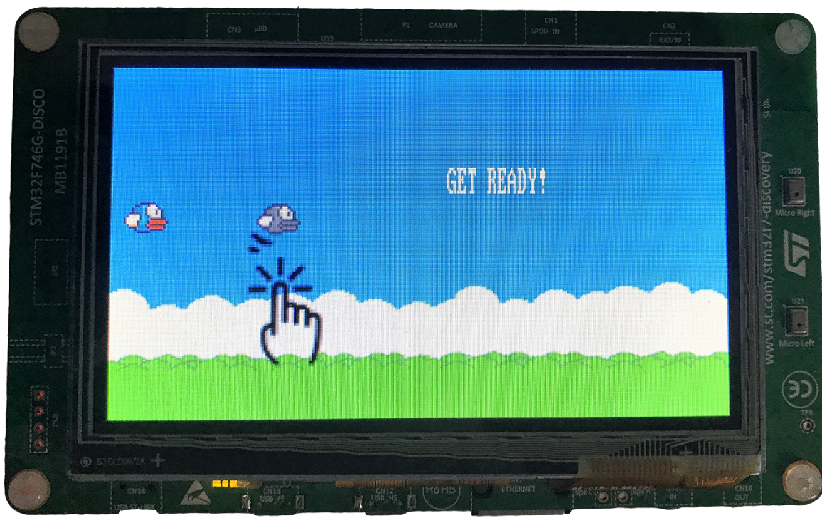
Pregame

Slide 4

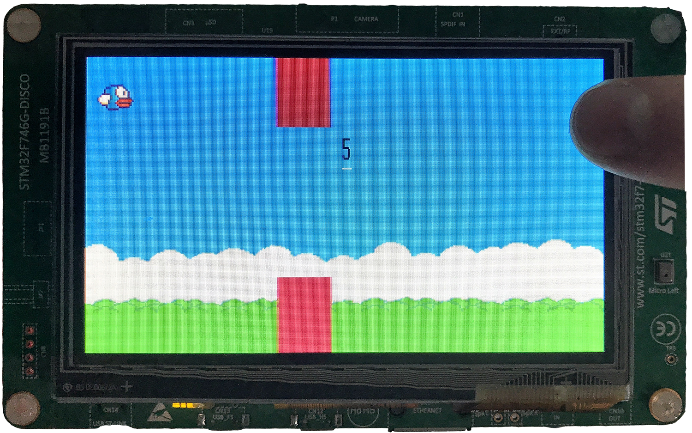
Difficulty:

Slide 5

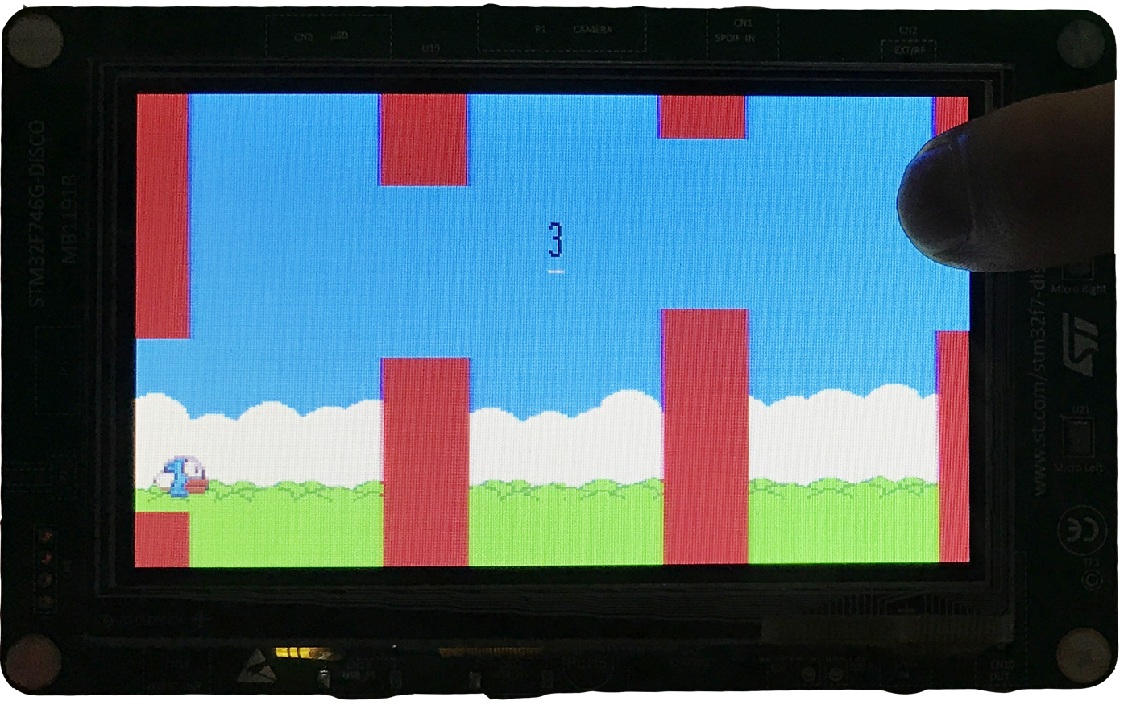
Difficulty:

Slide 6

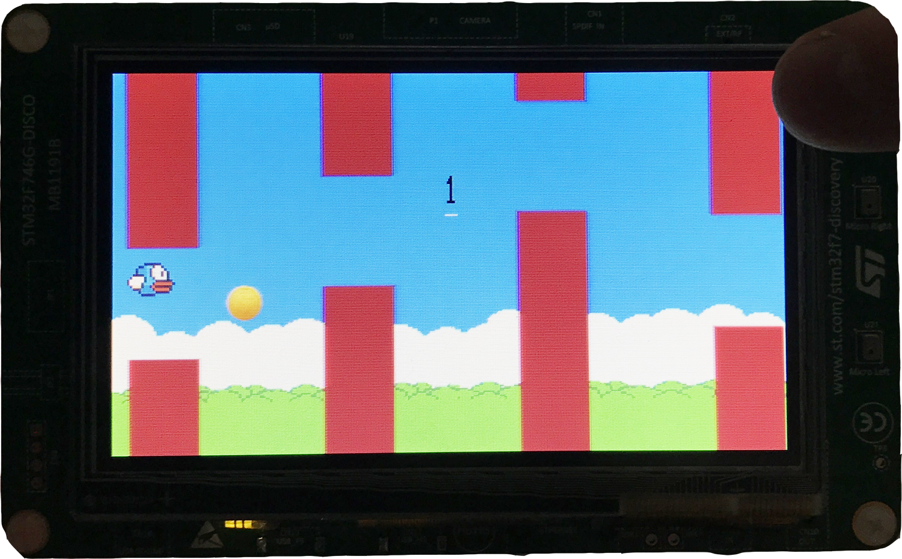
Difficulty:

Slide 7

Every Bird Wants Coins!
+3 Points!

Slide 8
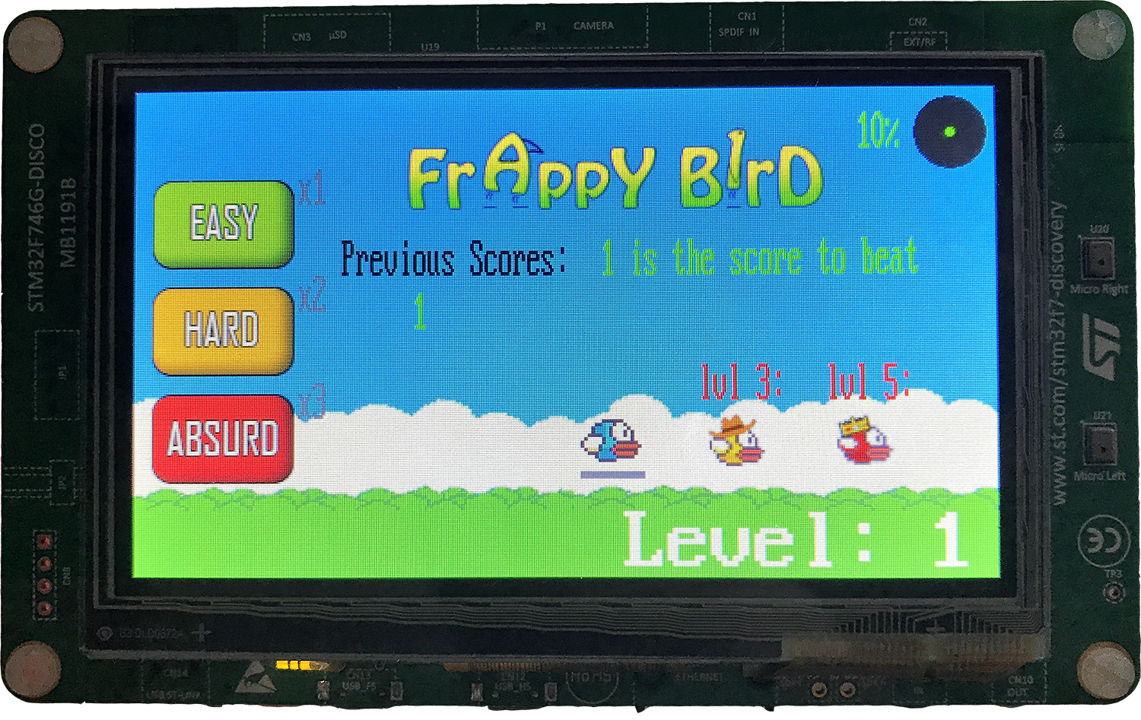
Main Menu

Slide 9
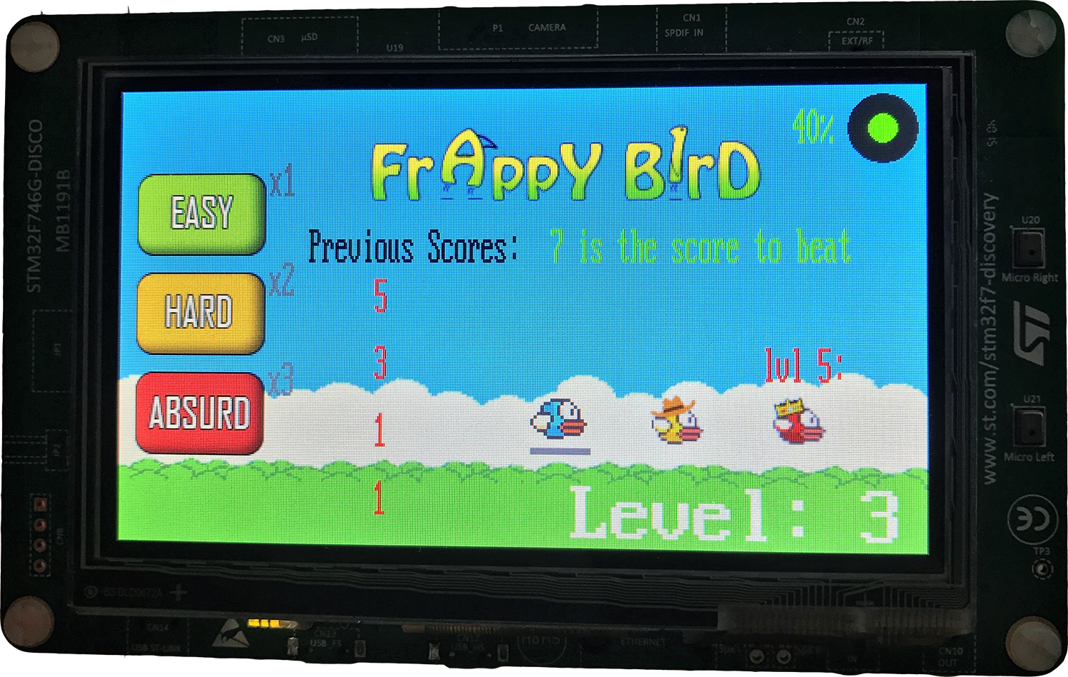
Unlocking Birds!

Slide 10
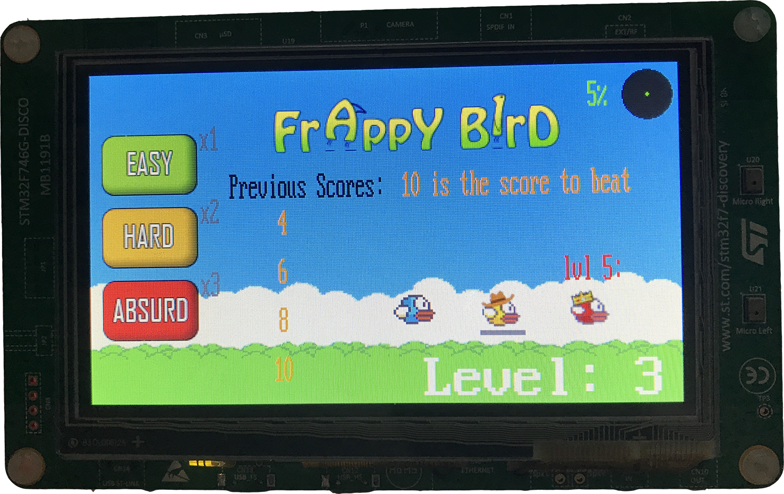
Choosing Birds!

Slide 11
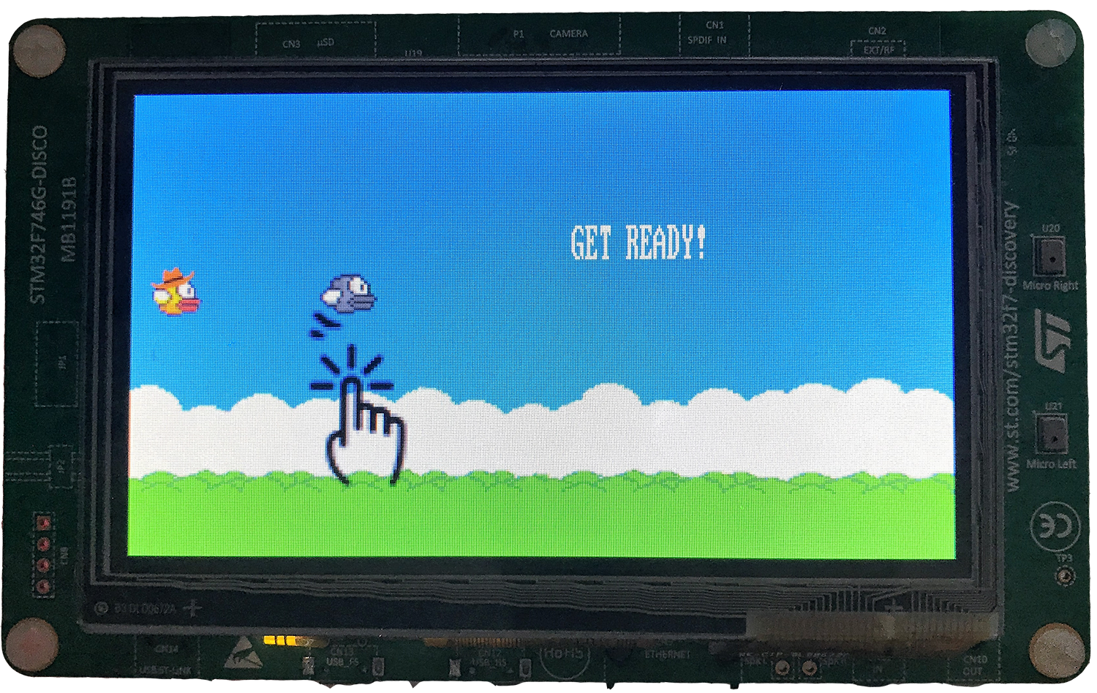
Try your new wings!

Slide 12
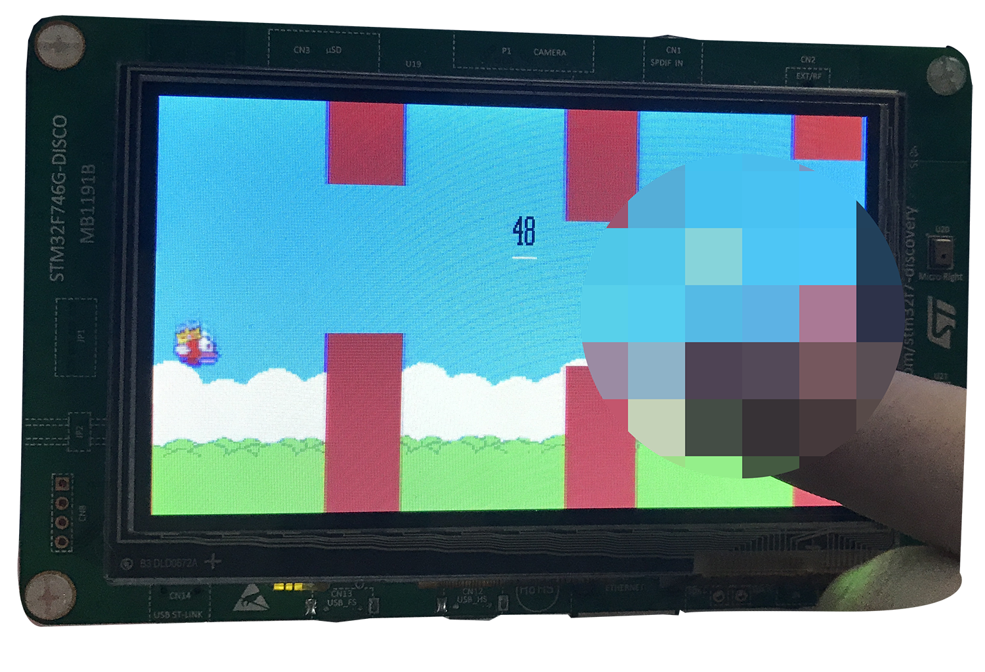
Easter Eggs!

